Slide 1
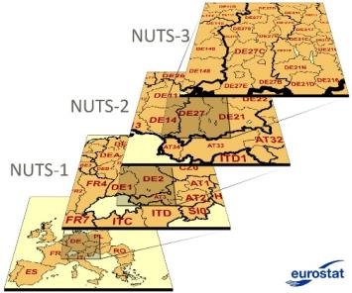
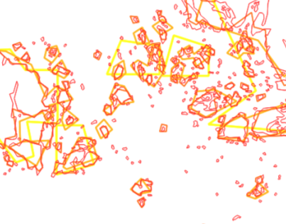
GISCO generalisation tool for tessellation datasets
GIS at EC - User and Technical Committee
22/03/2018
Julien Gaffuri – Eurostat/GISCO

Slide 2
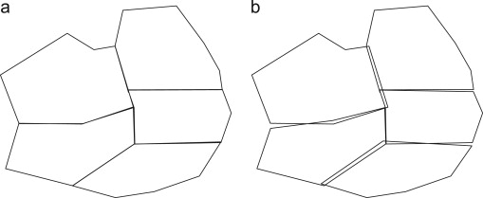
Objective
Generalisation for NUTS-COMMUNES-CNTR-EEZ dataset
"Geographical tesselation"

Slide 3
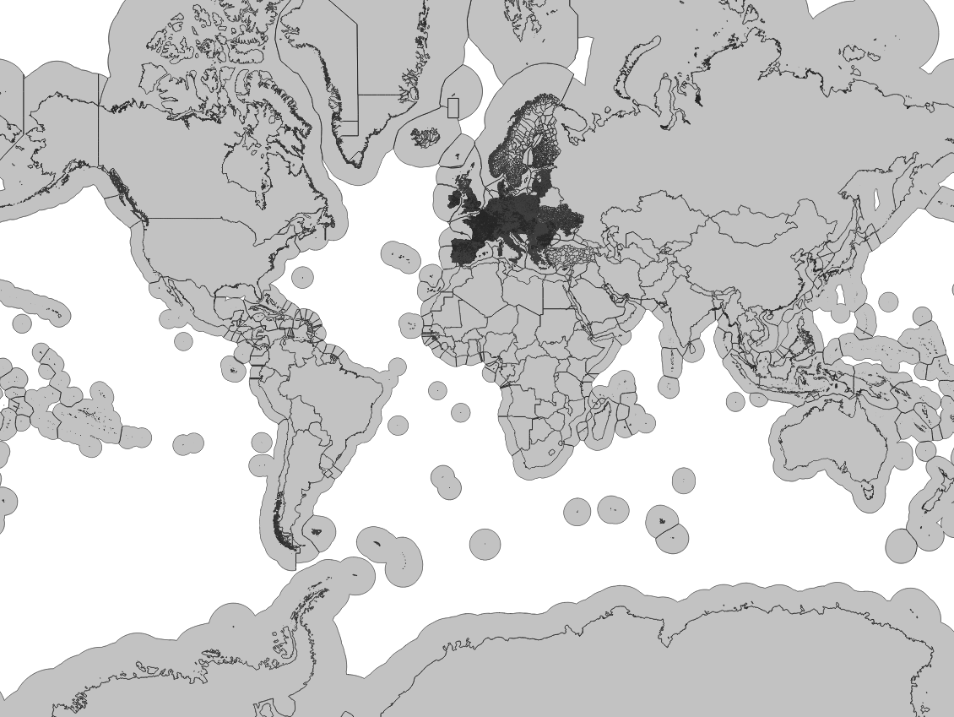
Input dataset:
European communes + World countries + EEZ
124 000 features
43M vertices

Slide 4
Automated generalisation for tesselations
Many tools to perform "quick and dirty" generalisation of tesselations
How to properly generalise tesselations?

Slide 5
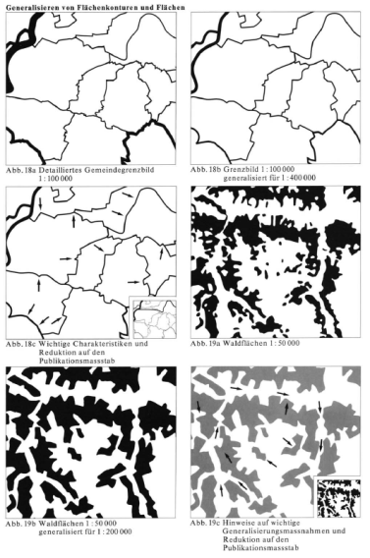
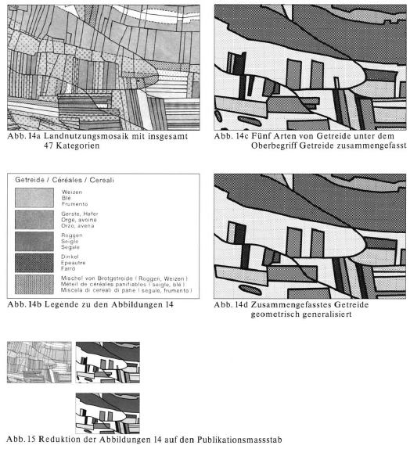
Some cartographic principles for tesselation generalisation

Slide 6
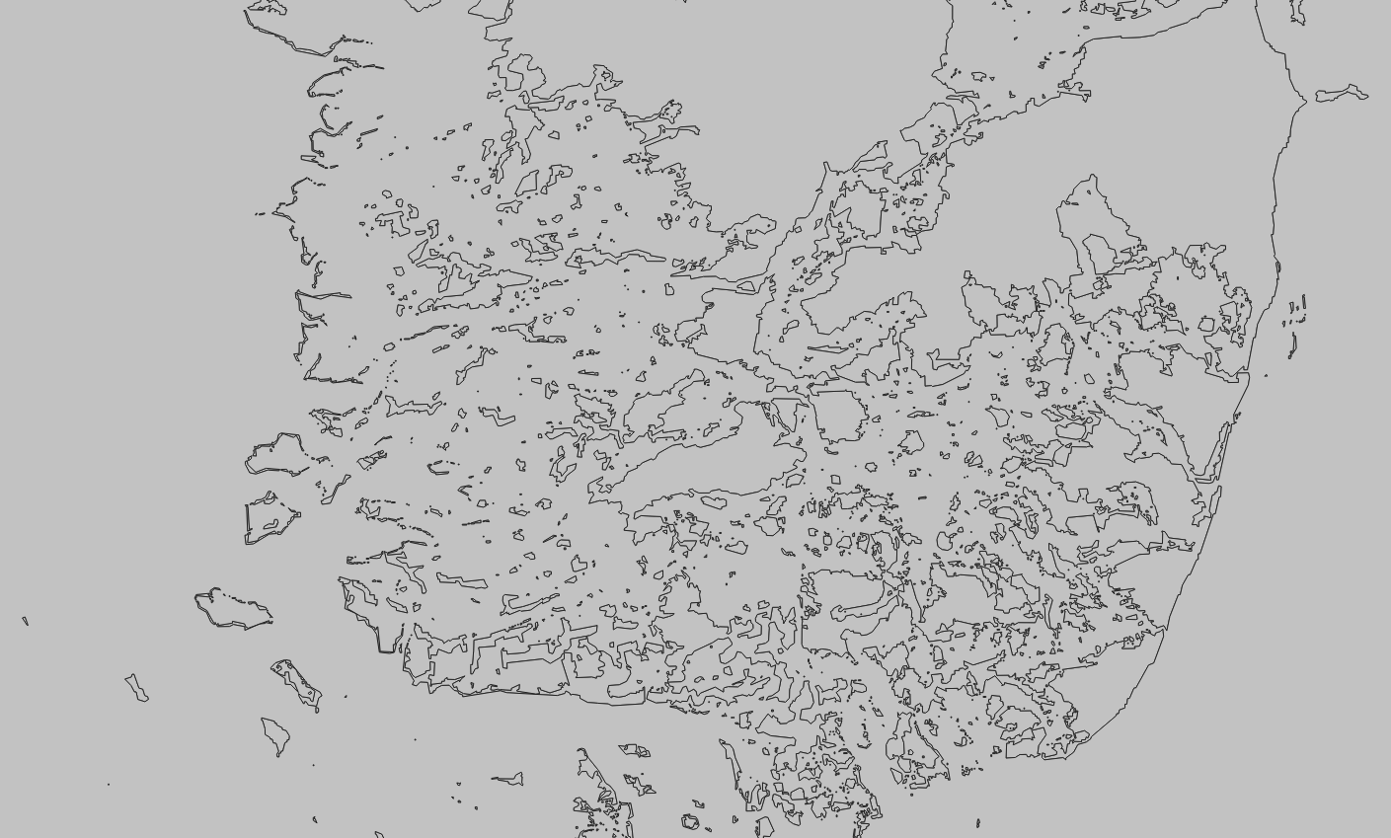
Challenge: Deal with complex situations
Bahamas

Slide 7
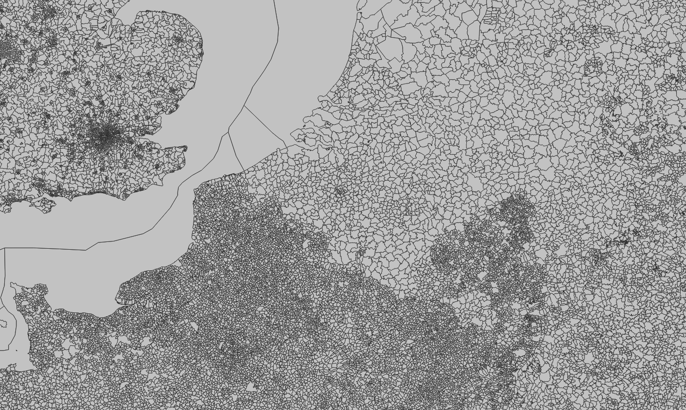
Challenge: Deal with complex situations
European municipalities

Slide 8
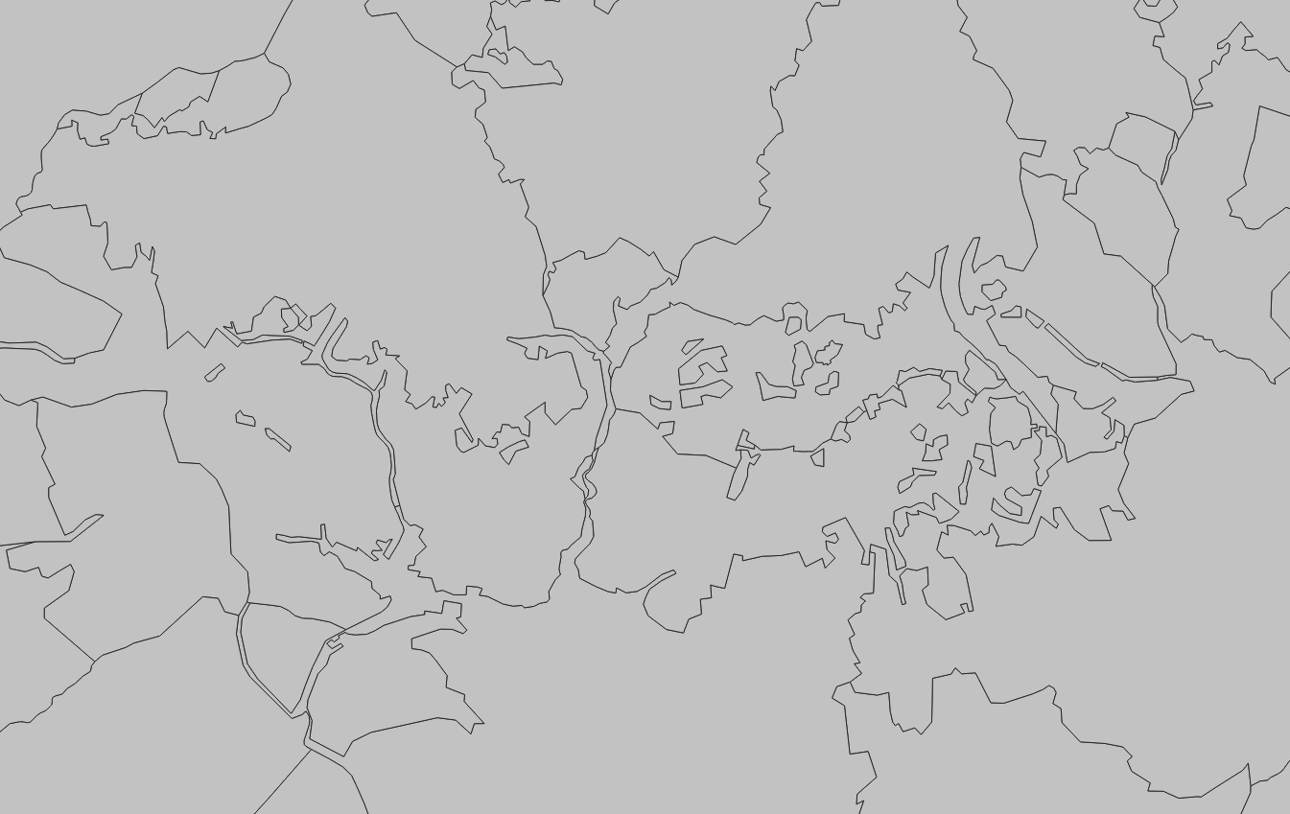
Challenge: Deal with complex situations
European municipalities

Slide 9
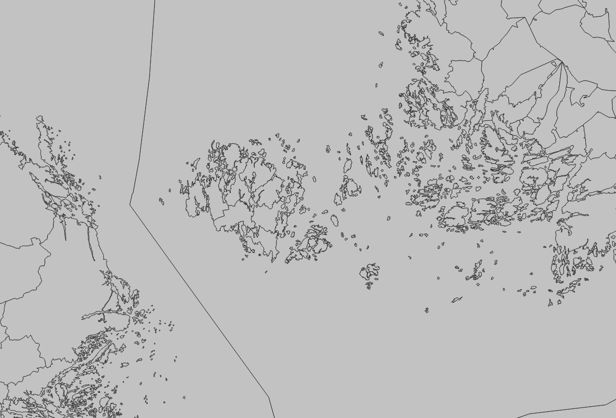
Challenge: Deal with complex situations
Baltic sea islands

Slide 10
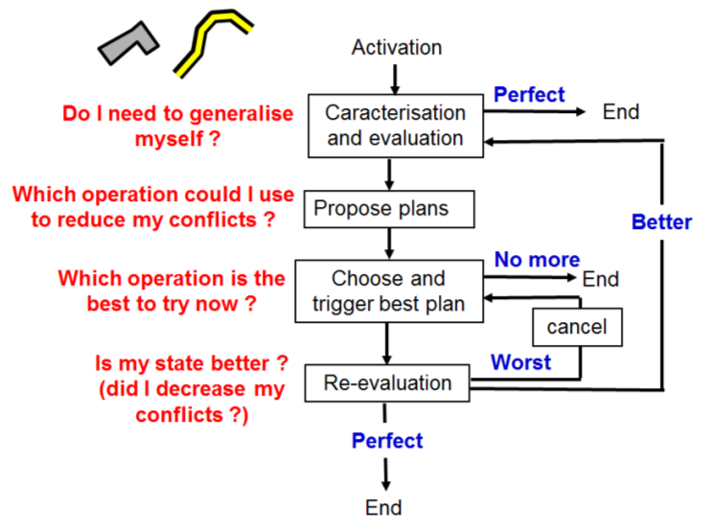
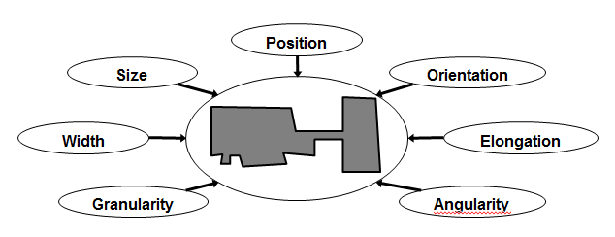
Approach adopted: Agent-based generalisation
Target state formalised as constraints at object level…
…constraints satisfied iterativelly at object level
Ruas, A., Duchêne, C., 2007. A prototype generalisation system based on the multi-agent system paradigm. In: Mackaness, W. A., Ruas, A., Sarjakoski, L. T. (Eds.), Generalisation of Geographic information: cartographic modelling and applications. Elsevier, Ch. 14, pp. 269-284

Slide 11
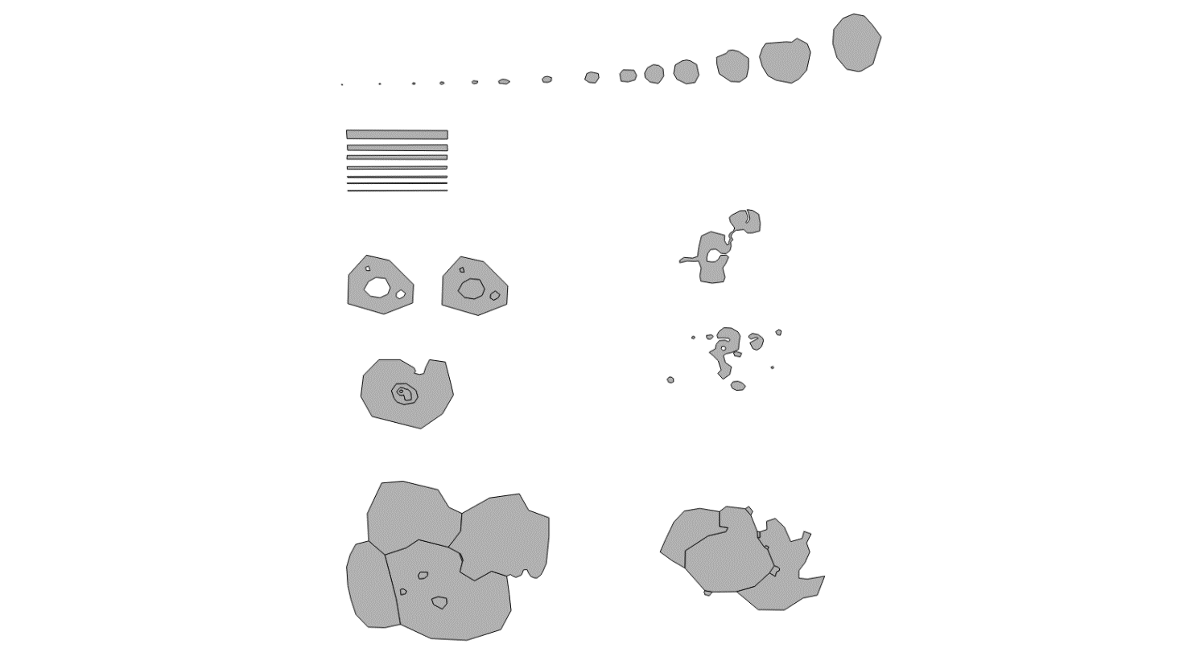

Slide 12
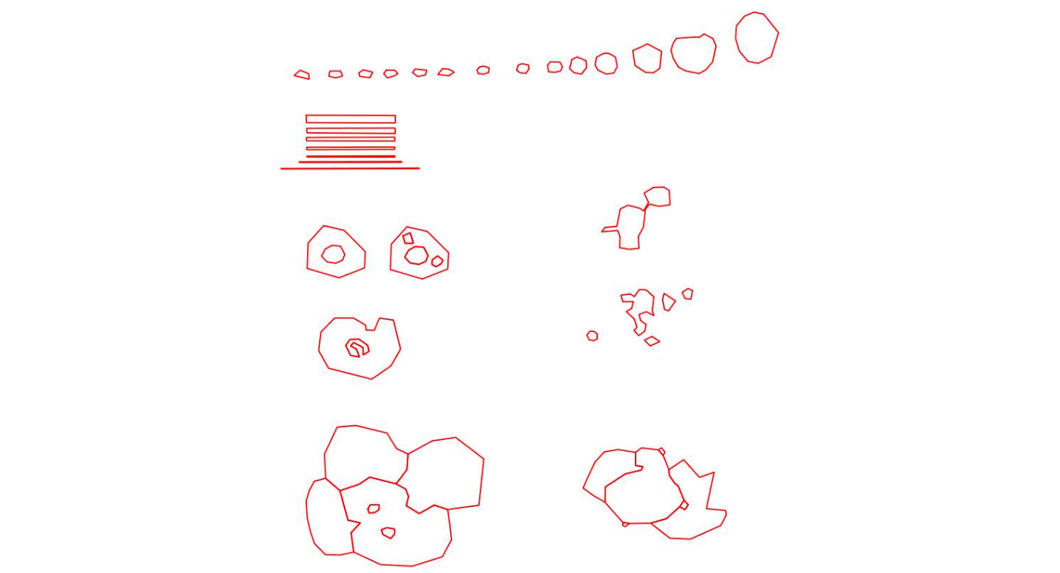

Slide 13
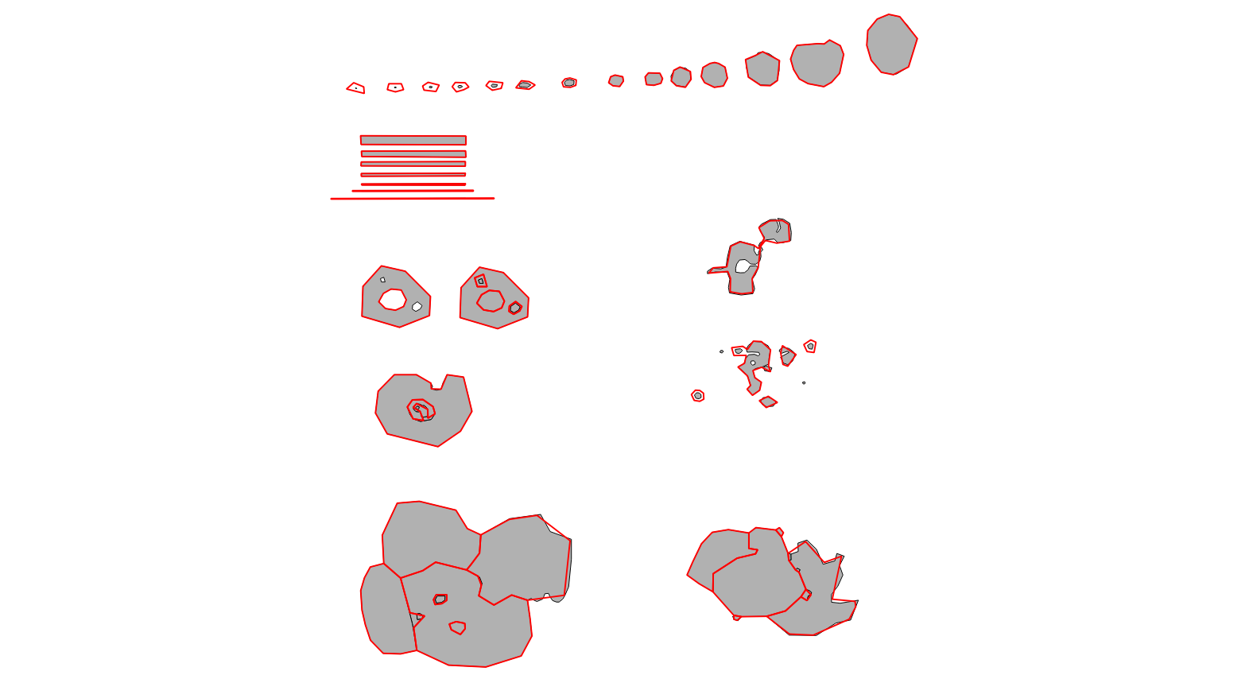

Slide 14
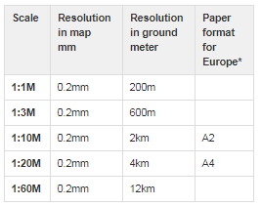
Constraints – threshold values

Slide 15
Results

Slide 16
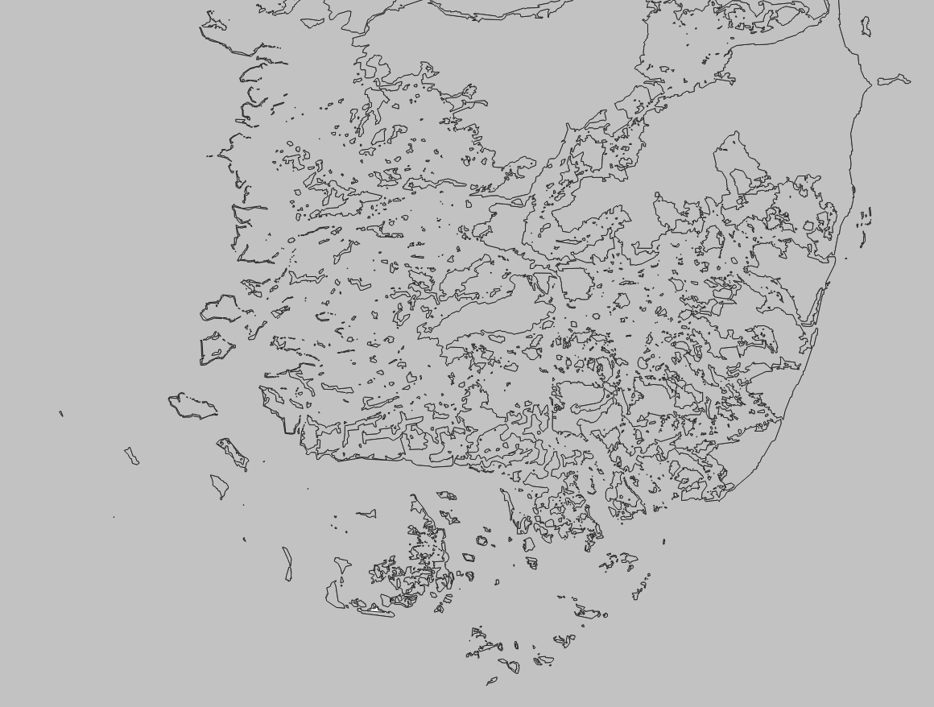
1:100k

Slide 17
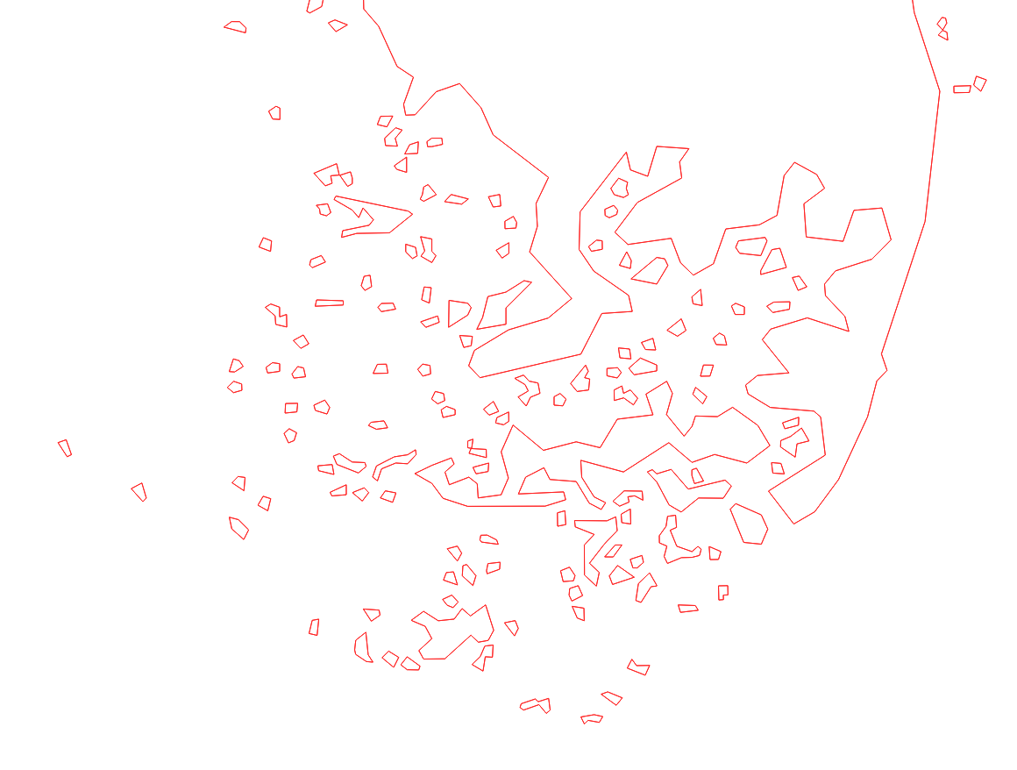
1:1M

Slide 18
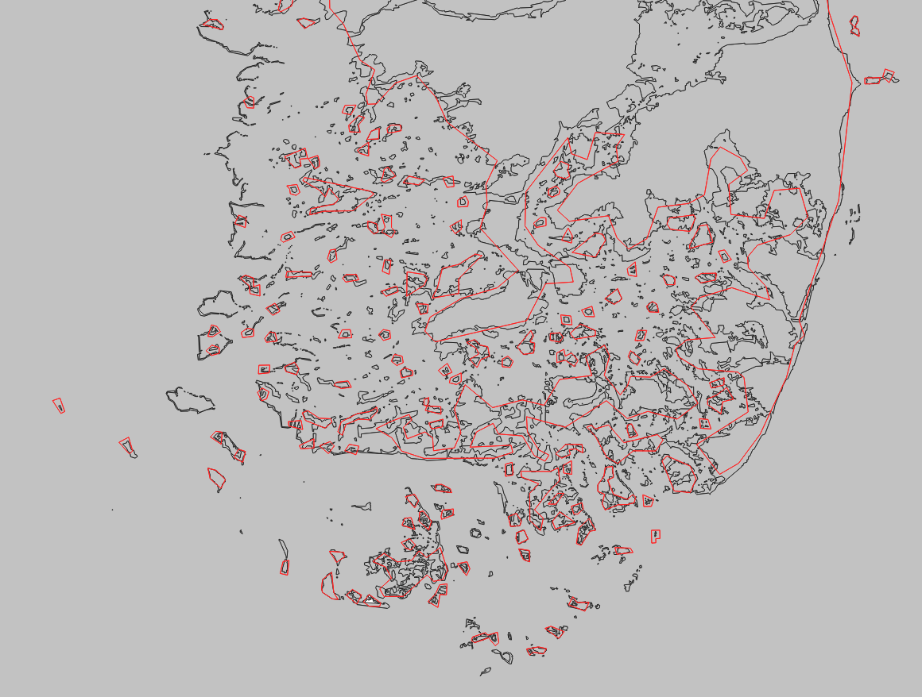
1:100k
1:1M

Slide 19
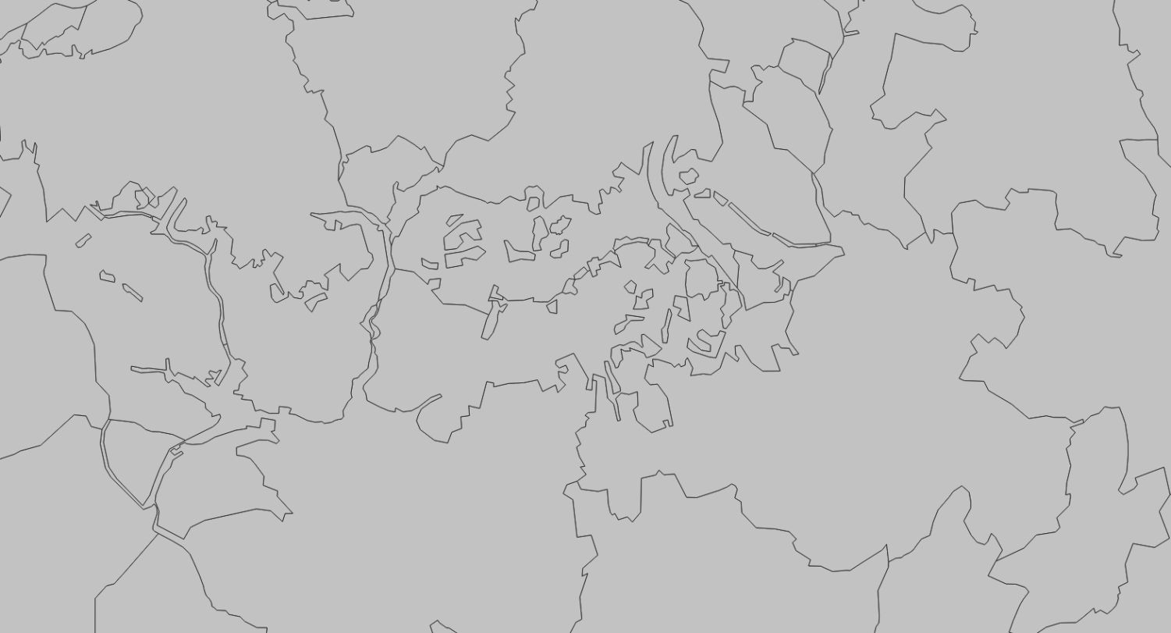
1:100k

Slide 20
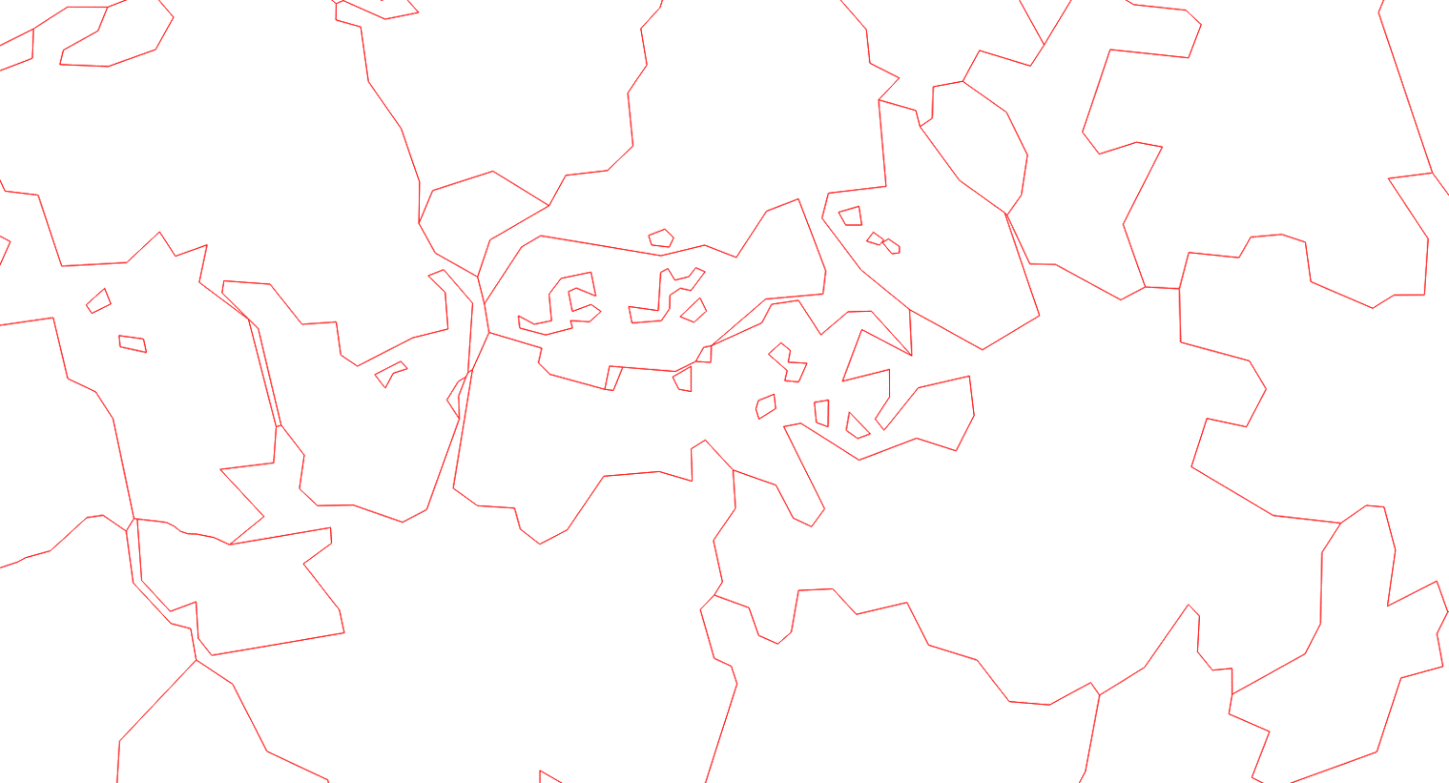
1:1M

Slide 21
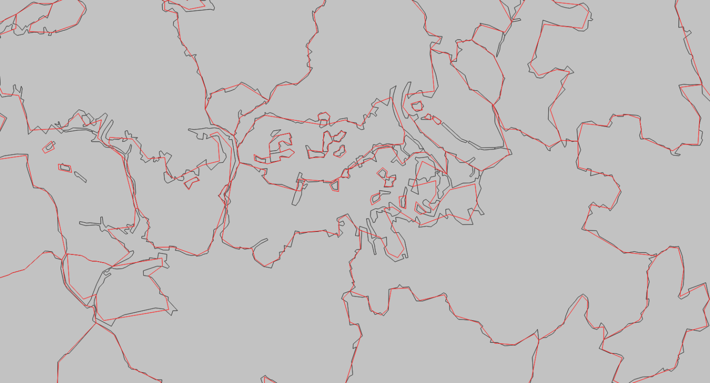
1:100k
1:1M

Slide 22

1:100k

Slide 23

1:1M

Slide 24
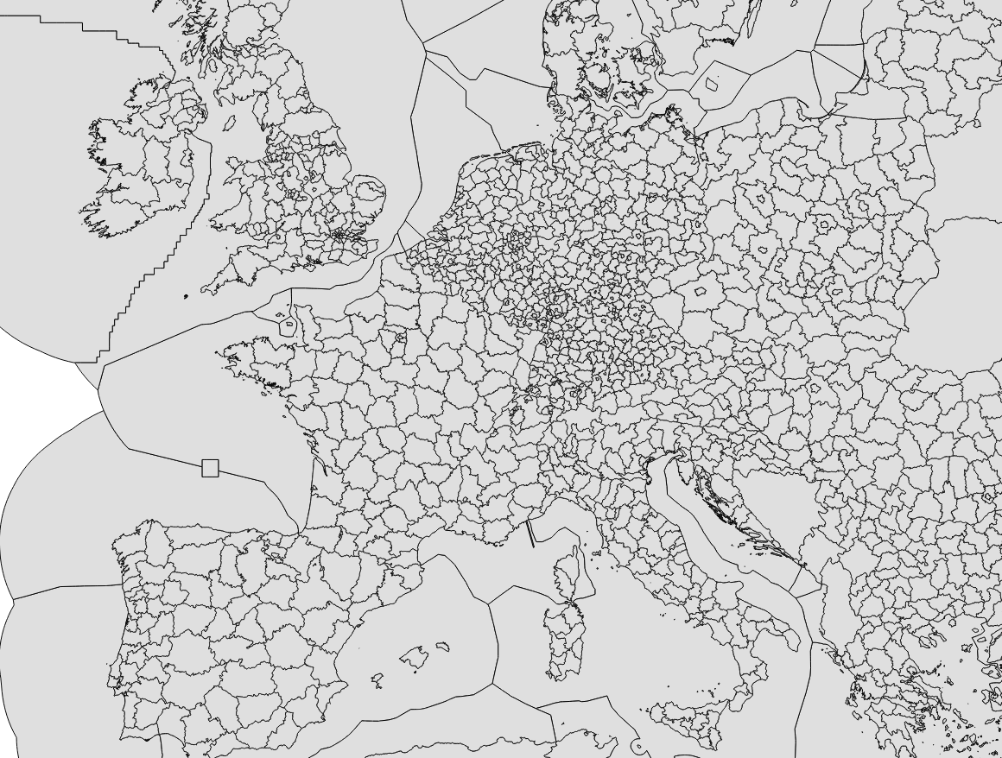
1:1M

Slide 25
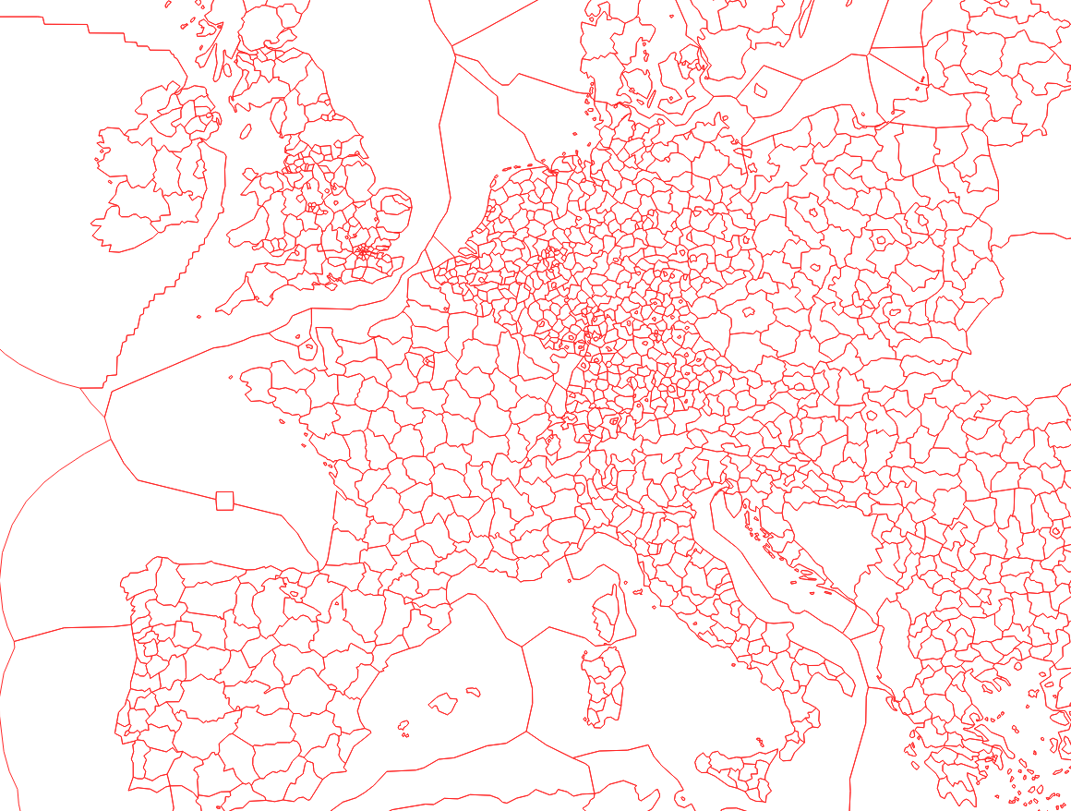
1:1M

Slide 26
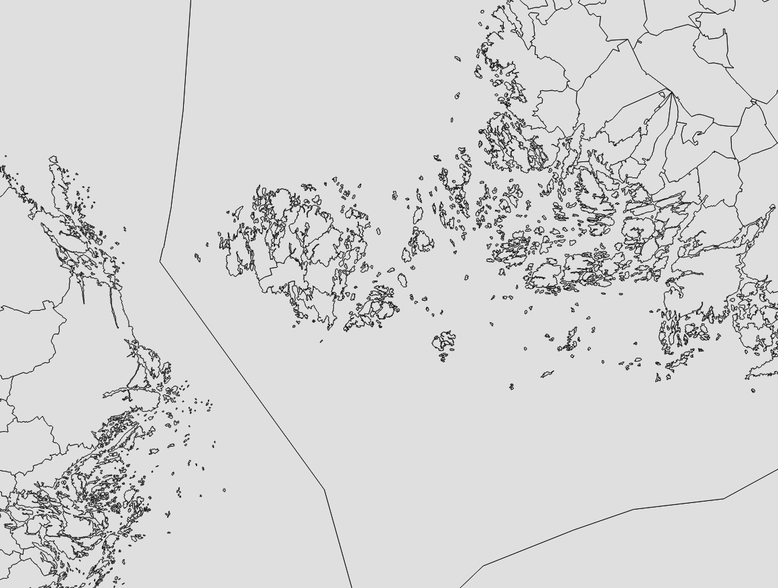
1:100k

Slide 27
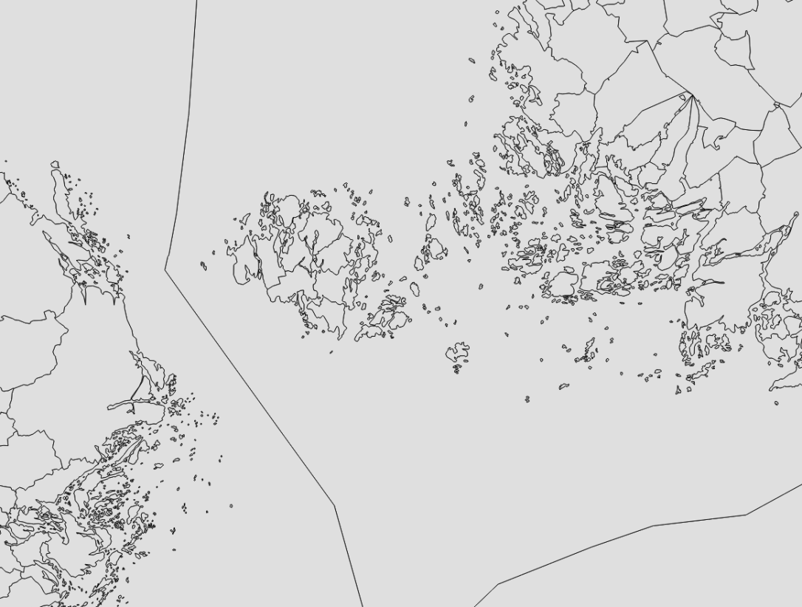
1:1M

Slide 28
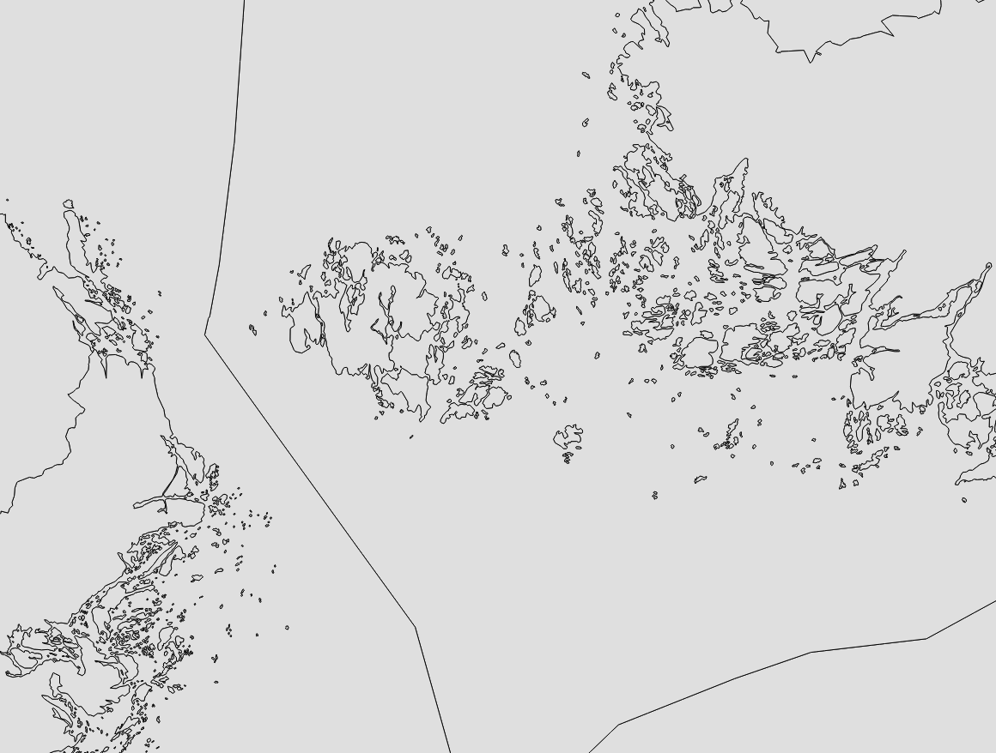
1:1M - NUTS

Slide 29
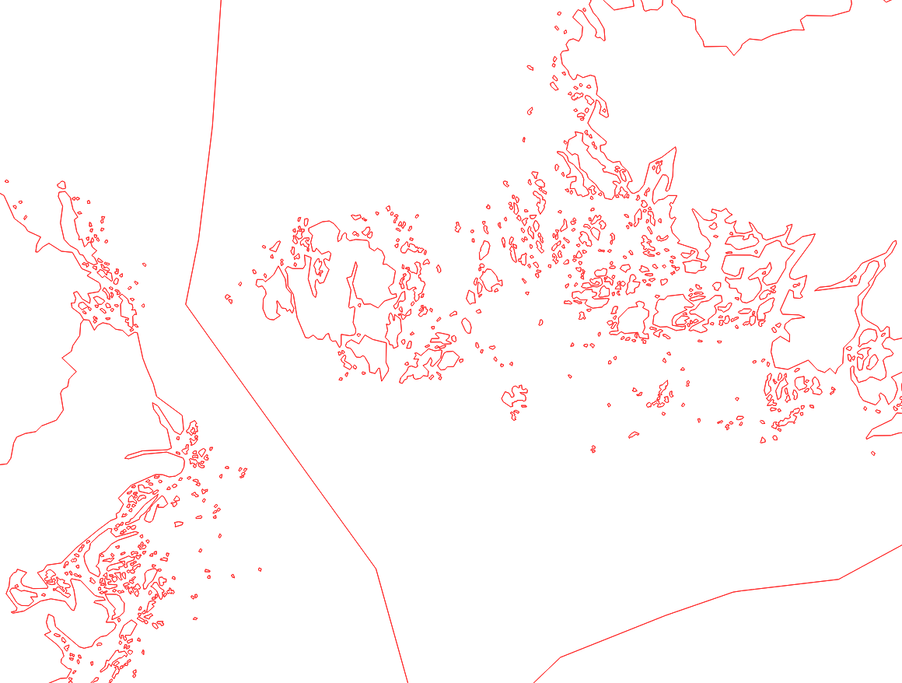
1:3M

Slide 30
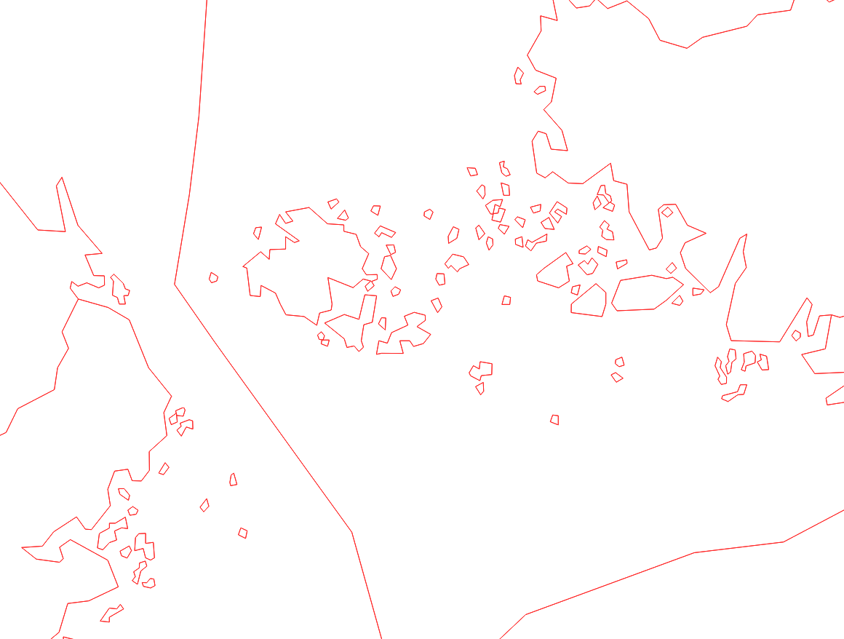
1:10M

Slide 31
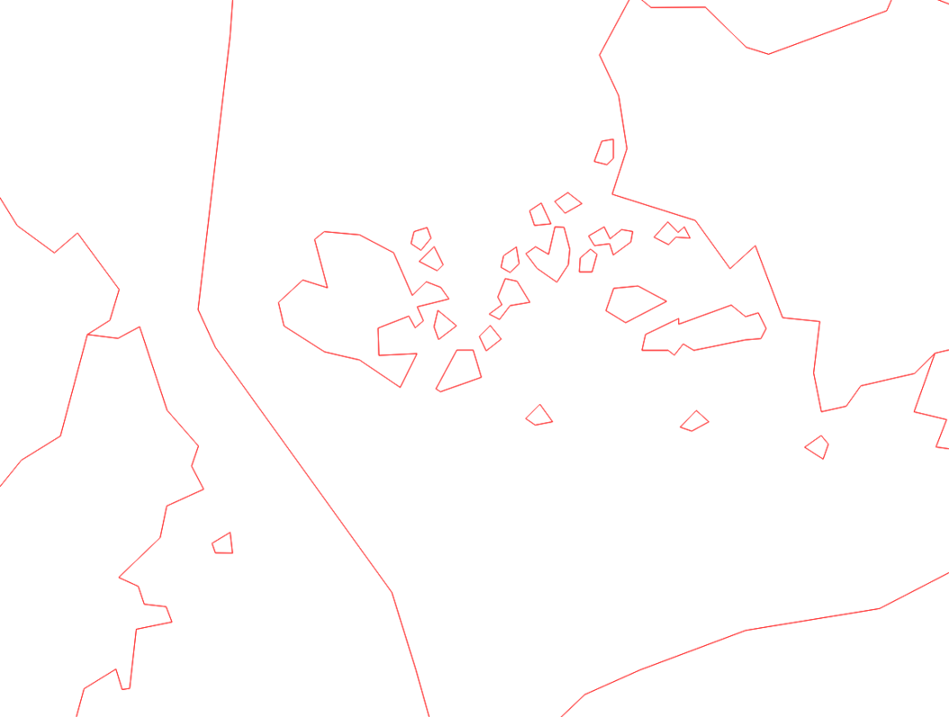
1:20M

Slide 32
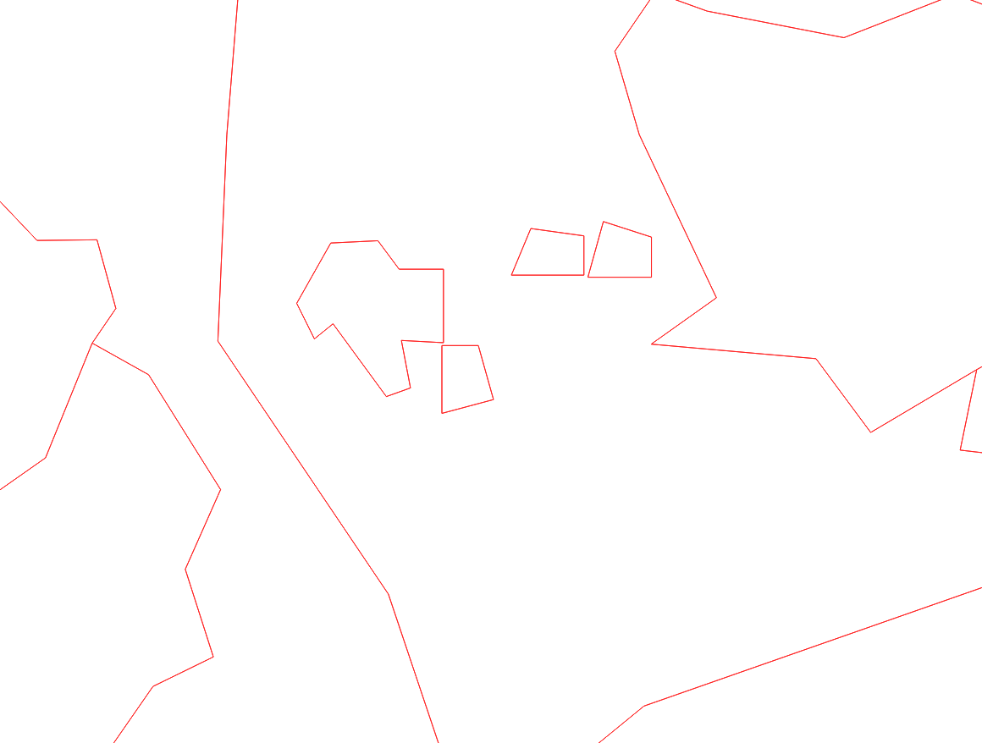
1:60M

Slide 33
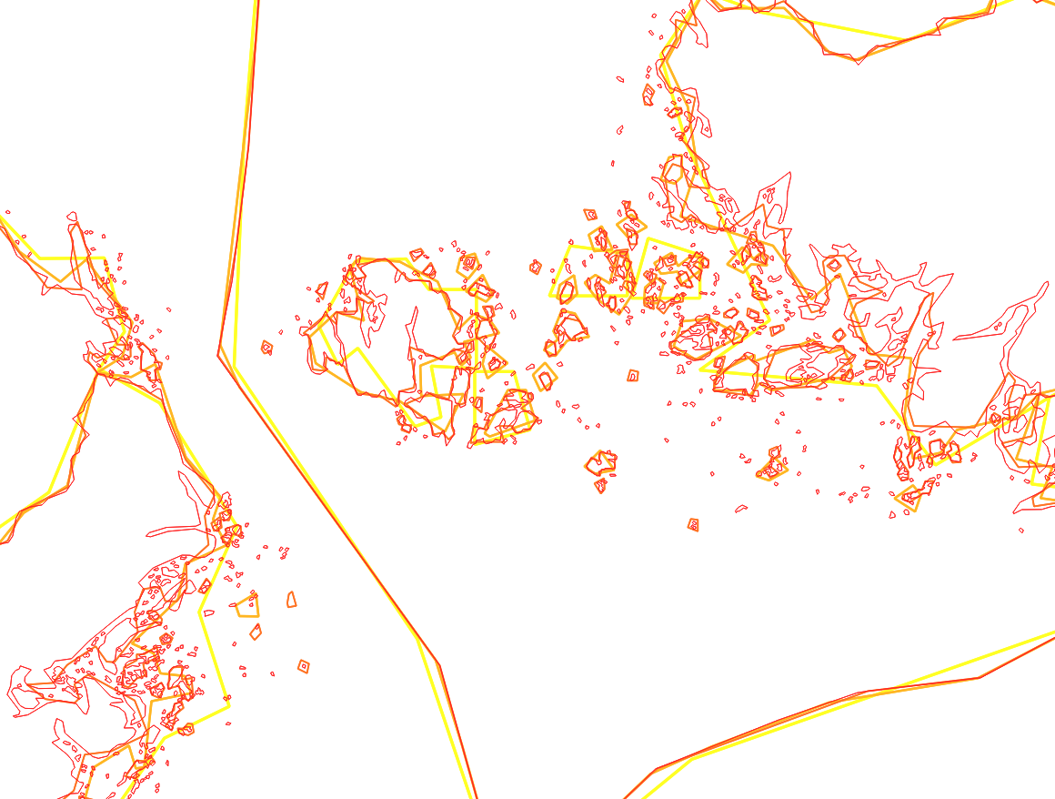
1:XM

Slide 34
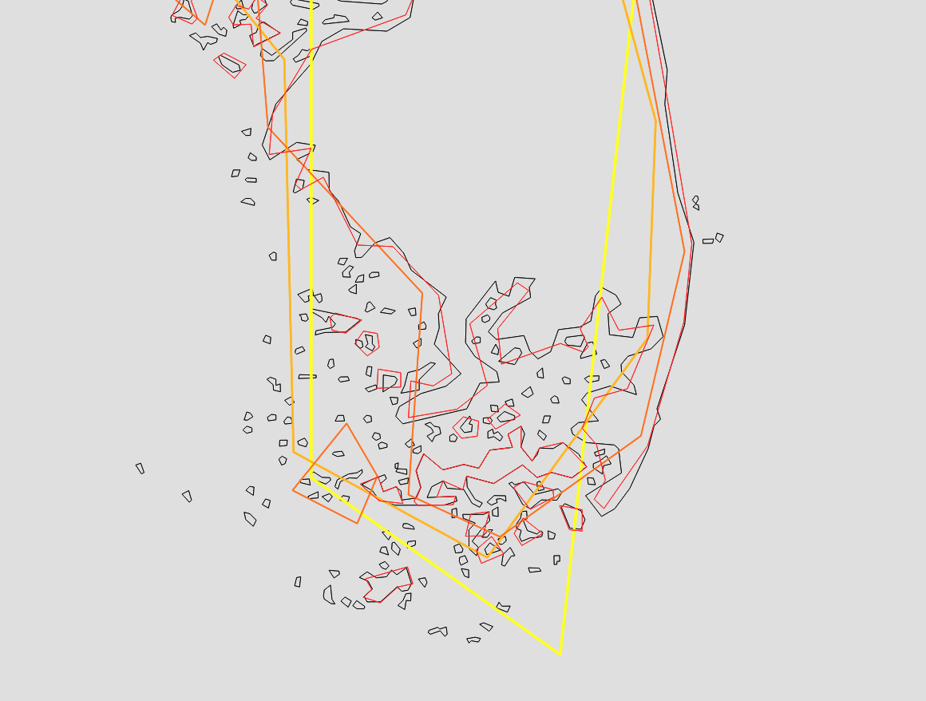
1:XM

Slide 35
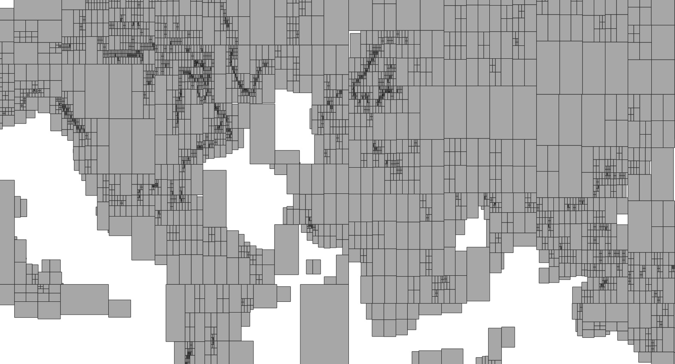
Partitionning

Slide 36
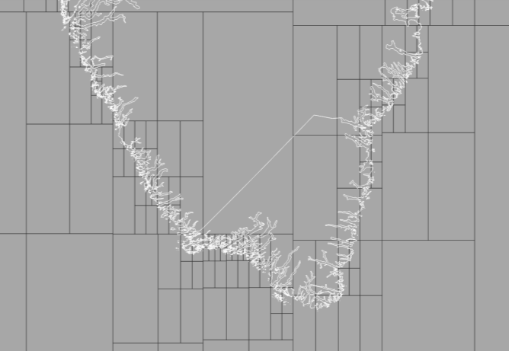
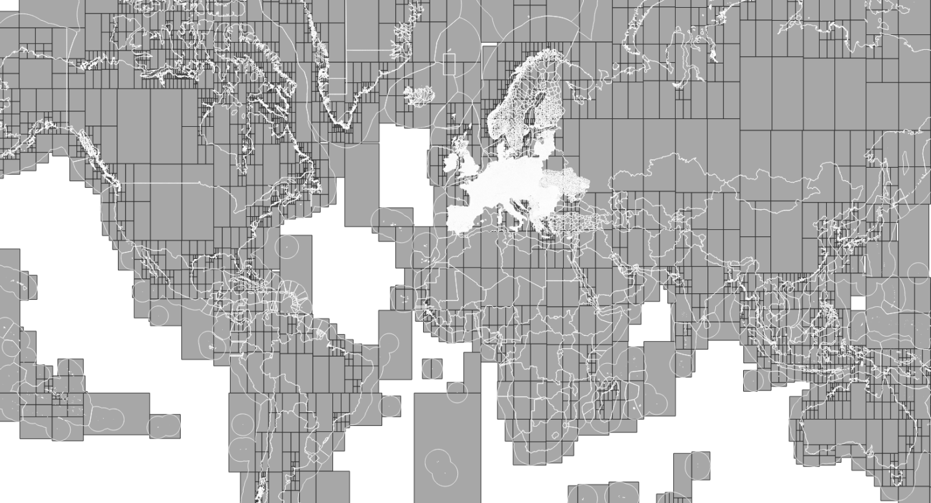
Partitionning

Slide 37
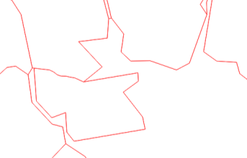
Next
Share tool as a standalone software:
https://github.com/eurostat/EuroGen/
Improvements:
New cartographic constraint to deal with narrow corridors

